Slide 1
E-Commerce Data Analysis Using SQL
Business Insights From E-Commerce Data

Slide 2

Introduction
E-Commerce (Electronic Commerce) is the process of buying and selling goods and services through the internet. It allows businesses and customers to perform transactions online using websites or mobile applications without visiting physical stores.
E-Commerce provides a convenient way for customers to search products, compare prices, place orders, and make digital payments from anywhere at any time. Businesses use e-commerce platforms to reach more customers, manage sales, and grow their market.
Examples of E-Commerce platforms: Amazon, Flipkart, eBay
Types of E-Commerce:

Slide 3
Objectives
Increase Sales – To sell products and services to more customers through online platforms.
Reach Global Customers – To expand business beyond local markets and reach customers worldwide.
Provide Convenience – To allow customers to buy products anytime and from anywhere.
Reduce Business Costs – To reduce expenses related to physical stores, marketing, and operations.
Improve Customer Service – To provide faster support, easy order tracking, and better shopping experience.

Slide 4
Database Tables
Category
Product
Supplier
Order_details
Customers

Slide 5
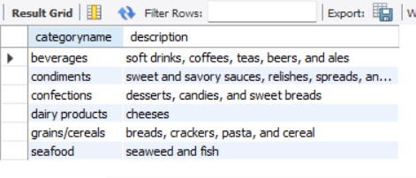
Create a report that shows the CategoryName and Description from the categories table sorted by CategoryName.
select categoryname, description from categories order by categoryname;
This report displays all product categories along with their descriptions.

Slide 6
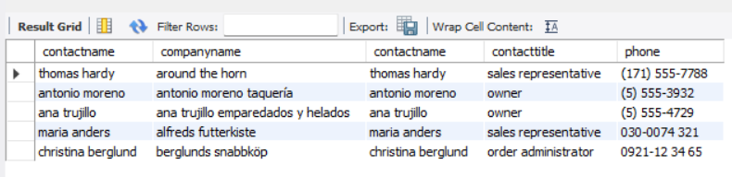
Create a report that shows the ContactName, CompanyName, ContactTitle and Phone number from the customers table sorted by Phone.
select contactname, companyname, contactname, contacttitle, phone from customers order by phone;
This report shows customer contact details sorted by phone number. It helps in easy customer identification, better communication, and efficient management of customer records.

Slide 7
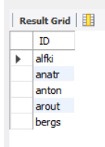
Create a report that shows all the CustomerID in lowercase letter and renamed as ID from the customers table.
select lower(customerid) as ID from customers ;
This report displays all Customer IDs in lowercase format with a renamed column as ID. It helps maintain consistent data formatting and makes customer identification easier.

Slide 8
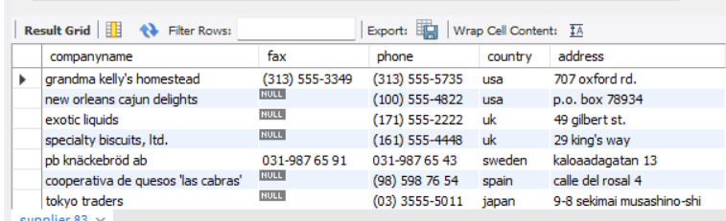
Create a report that shows the CompanyName, Fax, Phone, Country, HomePage from the suppliers table sorted by the Country in -- descending order then by CompanyName in ascending order.
select companyname, fax, phone, country, address from supplier order by country desc, companyname asc;
This report displays supplier contact details and is sorted by country in descending order and company name in ascending order. It helps in organizing supplier information and makes it easier to analyze and manage supplier records.

Slide 9

Create a report showing ProductName, UnitPrice, QuantityPerUnit of products that are out of stock.
select productname, unitprice, quantityperunit from product where unitsinstock = 0;
Create a report showing ProductName, UnitPrice, QuantityPerUnit of products that are out of stock.

Slide 10
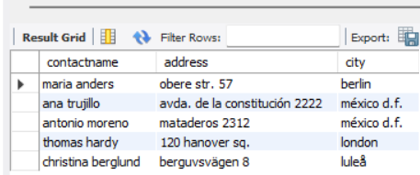
Create a report showing all the ContactName, Address, City of all customers not from Germany, Mexico, Spain.
select contactname, address, city from customers where city not in ("germany", "mexico", " spain");
This report shows customer details excluding customers from Germany, Mexico, and Spain. It helps analyze customers from other countries and supports better customer management and regional analysis.
.

Slide 11
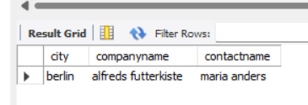
Create a report that shows the City, CompanyName, ContactName of customers from cities starting with A or B.
select city, companyname, contactname from customers where city like "A%" or city like "B%";;
Create a report that shows the City, CompanyName, ContactName of customers from cities starting with A or B.

Slide 12
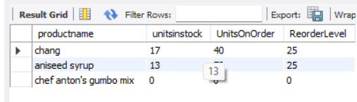
Create a report that shows the ProductName, UnitsInStock, UnitsOnOrder, ReorderLevel of all products that are up for reorder.
select productname, unitsinstock, UnitsOnOrder, ReorderLevel from product where unitsinstock <= unitsonorder;
Create a report that shows the ProductName, UnitsInStock, UnitsOnOrder, ReorderLevel of all products that are up for reorder.

Slide 13
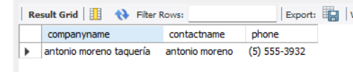
Create a report that shows the CompanyName, ContactName number of all customer that have no fax number.
select companyname, contactname, phone from customers where fax is null;
This report identifies products that have reached their reorder level. It helps the business monitor low inventory and take timely action to maintain stock availability.

Slide 14

Create a report that shows the CompanyName, ContactName, Fax of all customers that do not have Fax number and sorted by ContactName.
select CompanyName, ContactName, Fax from customers where fax is null order by contactname;
This report shows customers who do not have fax numbers available. It helps identify missing contact information and improves customer data management.

Slide 15
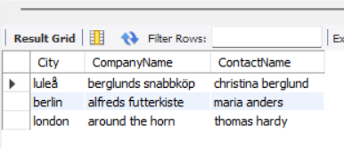
Create a report that shows the City, CompanyName, ContactName of customers from cities that has letter L in the name sorted by ContactName.
select City, CompanyName, ContactName from customers where city like "%l%" order by contactname;
This report shows customers from cities containing the letter L and sorts the data by Contact Name. It helps in filtering customer records and makes customer information easier to analyze and manage.
.

